Slide 1
Linked Lists, OOG, and Midterm Review
Kevin Wang

Slide 2
Slides:
links.cs61a.org/kevin-slides

Slide 3
Administrivia
Ants project due tonight!
Homework 6 due tomorrow!
Midterm next Tuesday! 8 - 10:00 PM
Includes lectures up to next Monday
2 cheat sheets allowed
Emphasis on recursion, mutable data, OOP, tree recursion, and recursive data (Linked Lists, Trees).

Slide 4
Administrivia Cont.
No discussion next week.
If you have questions, bring them to lab next week!
Labs are not mandatory next week, but are more like OH.
HKN and CSM should both have review sessions this weekend. Check Piazza for details.

Slide 5
Questions from last time:
What is super()?
Super is a function that calls the current object’s parent class.
We don’t really use it in this class!

Slide 6
Linked Lists

Slide 7
Linked Lists
A linked list object is either empty or an object consisting of a first and a rest.
Rest must consist of either a Link.empty or another Linked List!
Because of this, linked lists are recursive data structures, similar to trees.
Can usually recursively call your function on the rest!
First can be any data type!
1
2
3

Slide 8
Worksheet!

Slide 9
Orders of Growth

Slide 10
Orders of Growth
When we write functions, we care about how the runtime of the function grows asymptotically
We only care about how the runtime of a function changes with respect to different inputs we put in.
Basically, for a function foo(), how does the runtime change if we pass in 1? 1,000,000?

Slide 11
Constant: Θ(1)
No matter what input I pass into the function, the runtime of that function stays the same.
def func1(n):
return 1
def func2(n):
for i in range(1000000):
print(i)

Slide 12
Logarithmic: Θ(log(n))
You need to scale your input by some integer k each time to increment your runtime by one step
For this function, how many steps would it take to process an input of 100? How many additional steps would it take if I increased the input to 200?
def func3(n):
while n > 1:
print(n)
n = n / 2

Slide 13
Linear: Θ(n)
As your input increases, your runtime increases by the same ratio.
def func4(n):
for i in range(n):
print(i)

Slide 14
Quadratic: Θ(n^2)
As your input increases by 1, the runtime of your function increases by n.
def func5(n):
for i in range(n):
for j in range(n):
print(i + j)

Slide 15
Exponential: Θ(2^n)
As your input increases by 1, the runtime of your function doubles.
Can also say: Θ(branching_factor^n), where branching_factor is how many recursive calls we make.
def func6(n):
if n == 0:
Return 0
elif n == 1:
return 1
return func6(n-1) + func6(n-2)

Slide 16
Rule #1
Ignore constant multipliers.
Ex: 2N ⇒ N

Slide 17
Rule #2
Ignore all lower order terms.
Ex: N^2 + N ⇒ N^2

Slide 18
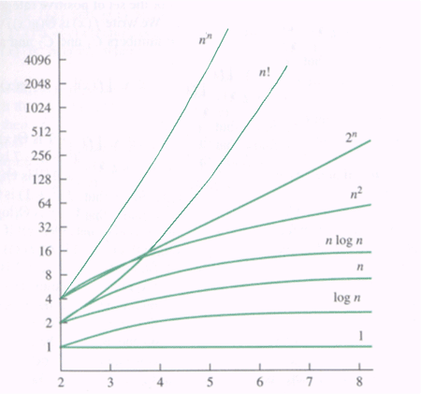

Slide 19
Worksheet!

Slide 20
Attendance!
links.cs61a.org/kevinwang-disc

Slide 21
links.cs61a.org/kevin-disc

Slide 22
Studying for the midterm...

Slide 23
Midterm Review:
Tree recursion,
List comprehensions,
trees

Slide 24
Exam Level Question: Spring 2016 Final Q10a

Slide 25
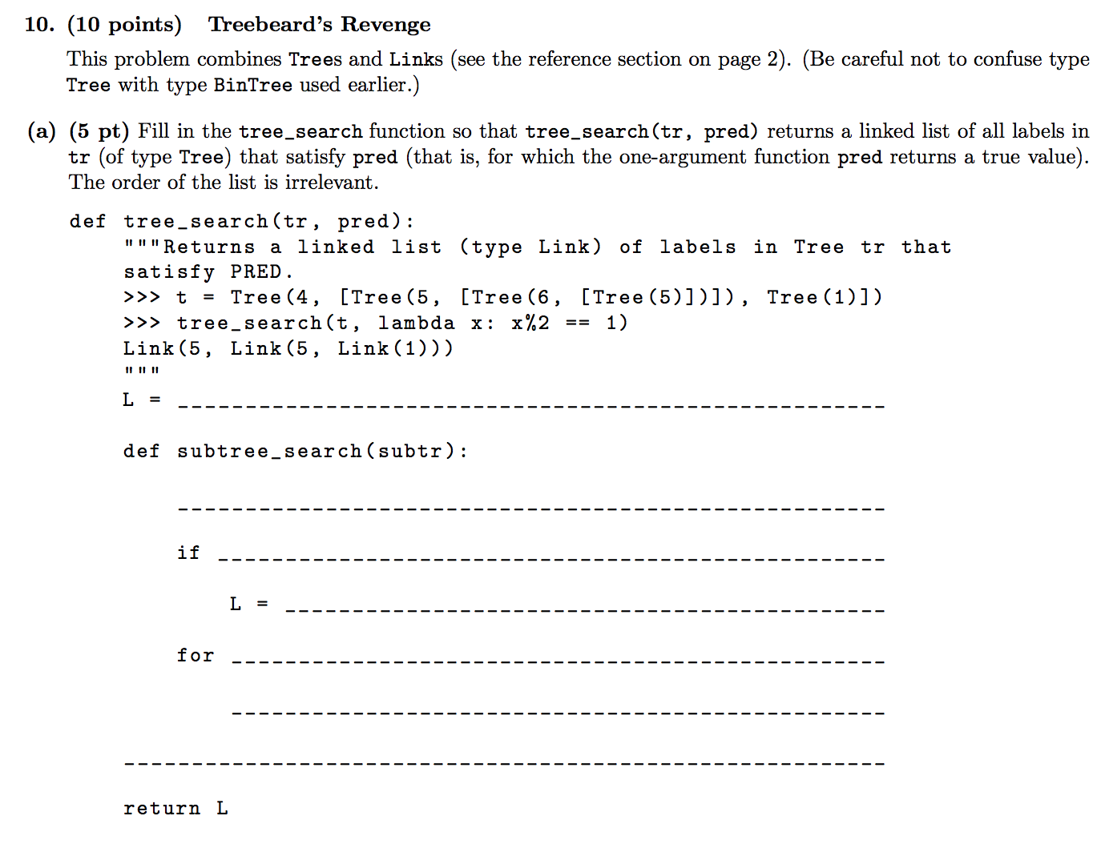

Slide 26
